Slide 1


Unitary limit Fermions under trap
And Dripline
Young-Ho Song (IRIS, IBS),
Myungkuk Kim ,Youngman Kim (CENS,IBS)
NLEFT collaboration
2024.04.26. KPS meeting, Daejeon

Slide 2
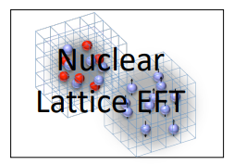
Nuclear Lattice Effective Field Theory Collaboration
Serdar Elhatisari(Gaziantep Islam Science and Technology)
Lukas Bovermann(Ruhr)
Evgeny Epelbaum (Bochum)
Dillon Frame (Juelich)
Fabian Hildenbrand(Darmstadt)
Hermann Krebs(Ruhr)
Timo A. Lähde (Juelich)
Dean Lee (MSU)
Ning Li(Sun Yat-sen)
Bing-Nan Lu( Graduate School of China Academy of Engineering Physic)
Myungkuk Kim(CENS,IBS)
Youngman Kim (CENS,IBS)
Young-Ho Song(IRIS,IBS)
Yuan-Zhuo Ma(Peking)
Ulf-G. Meißner (Bonn/Juelich)
Gautam Rupak(Mississippi State)
Shihang Shen (Juelich)
Gianluca Stellin( CEA Paris-Saclay)
And More…

Slide 3
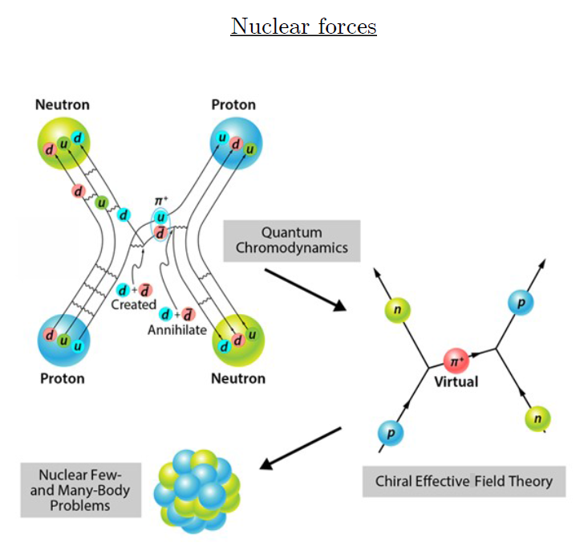
Ab-initio method
ab-initio Nuclear Physics
(1) nucleon degrees of freedom
(2) nucleon-nucleon interaction
Goal: predict wide range(structure, reaction, nuclear matter) of nuclear phenomena (without parameter fitting, model assumption) from nuclear interaction (for 2-body,3-body, many-body, based on QCD)
Direct connection between
Nuclear Force ↔ Nuclear Phenomena

Slide 4
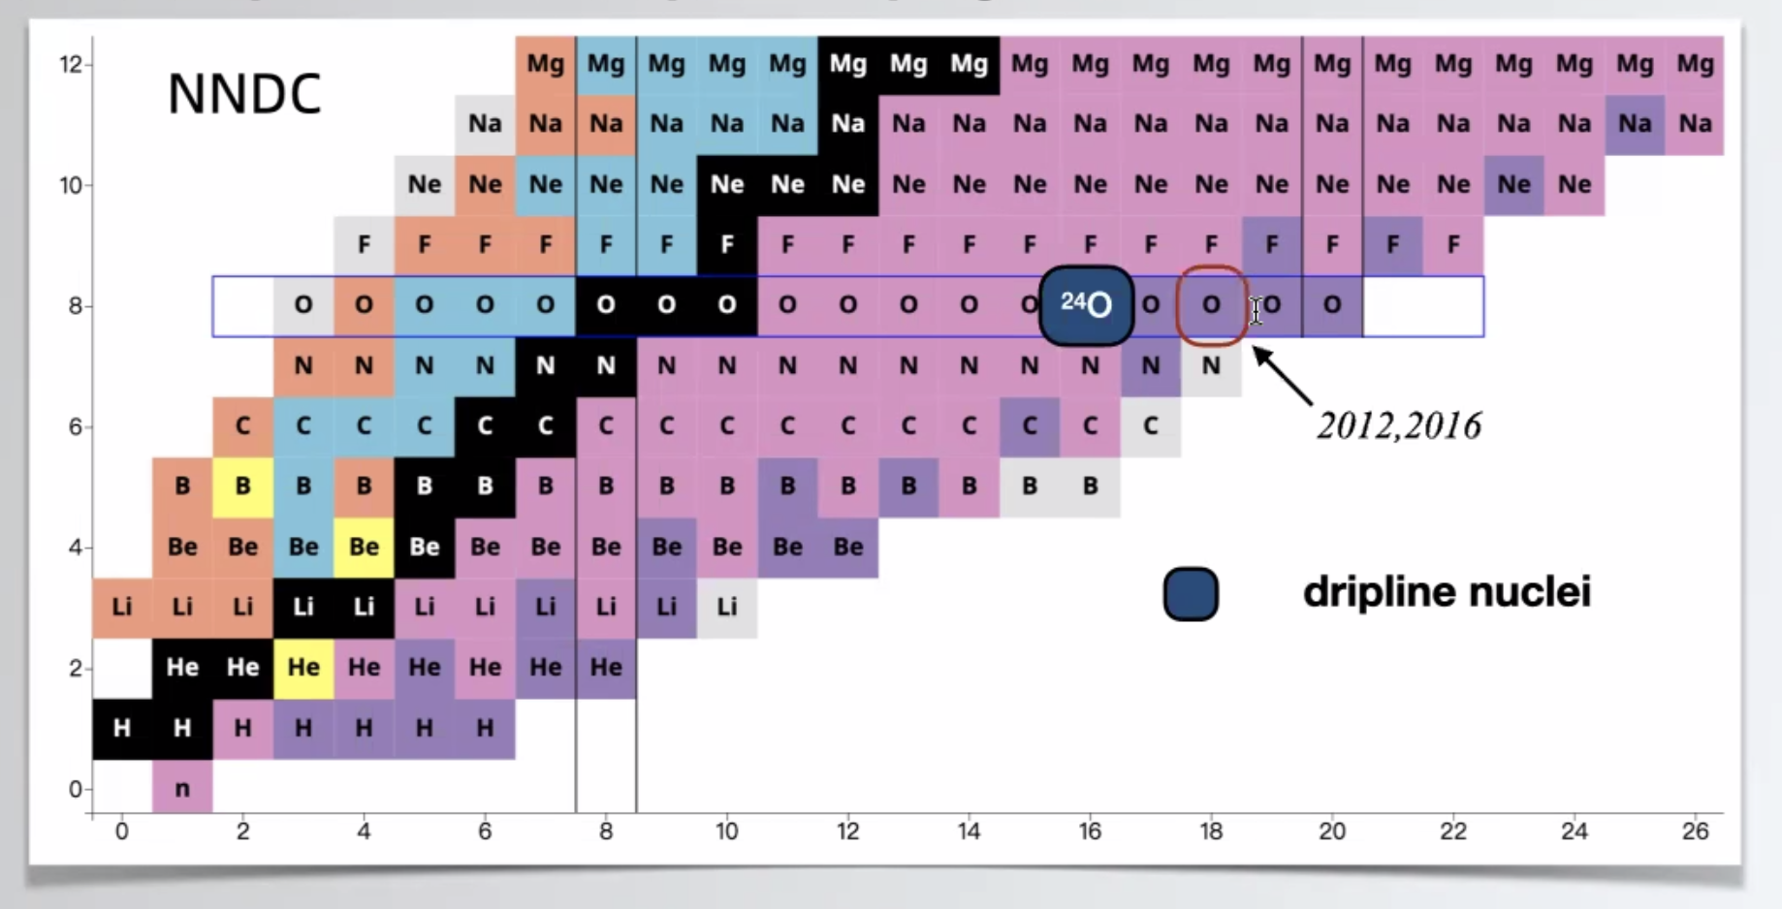
Dripline
Can we explain the dripline in NLEFT?
Can we find a effective mean-field from NLEFT?

Slide 5
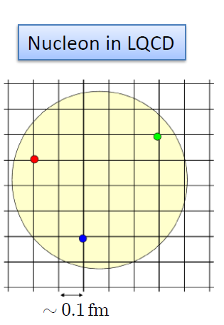
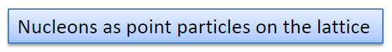
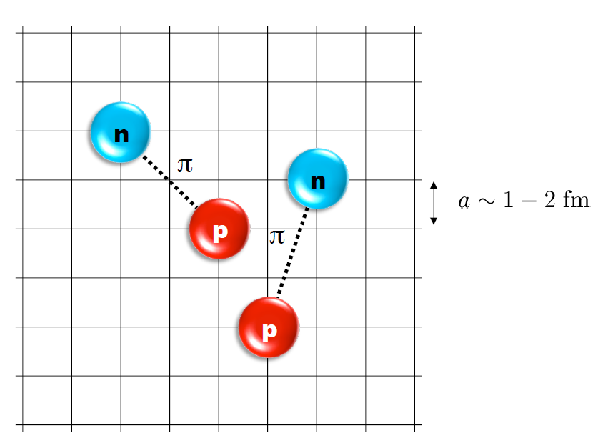
Nuclear Lattice Effective Field Theory
One of ab initio method for many fermion system

Slide 6
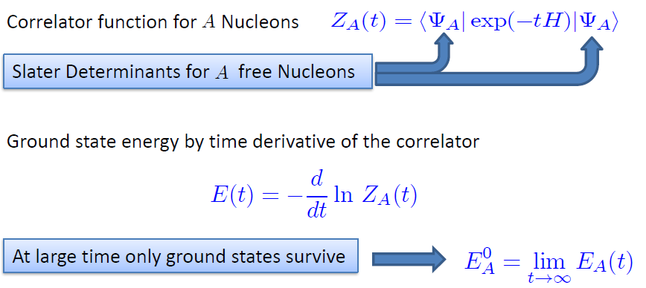
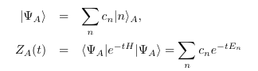
Path integral

Slide 7
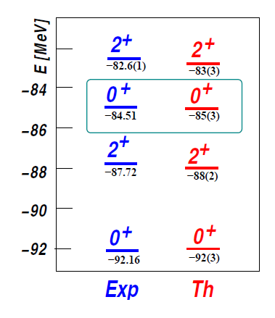
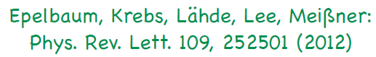
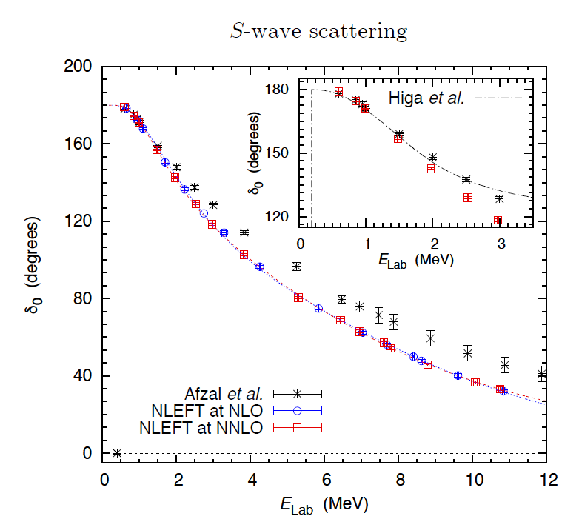
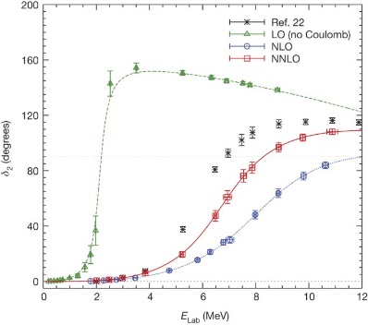
Applications of NLEFT
The first ab-initio calculation of
Hoyle state
Has been successfully applied to
Nuclear matter, Cold atom, dilute fermion system
Finite nuclei (A<=60)
First ab-initio calculation of Hoyle state
Cluster structure of ¹²C and ¹⁶O
NN scattering, N-D scattering
Alpha-alpha scattering
radiative capture, fusion
Etc.
Ab initio alpha-alpha scattering
( Nature 528, 111-114(2015))

Slide 8
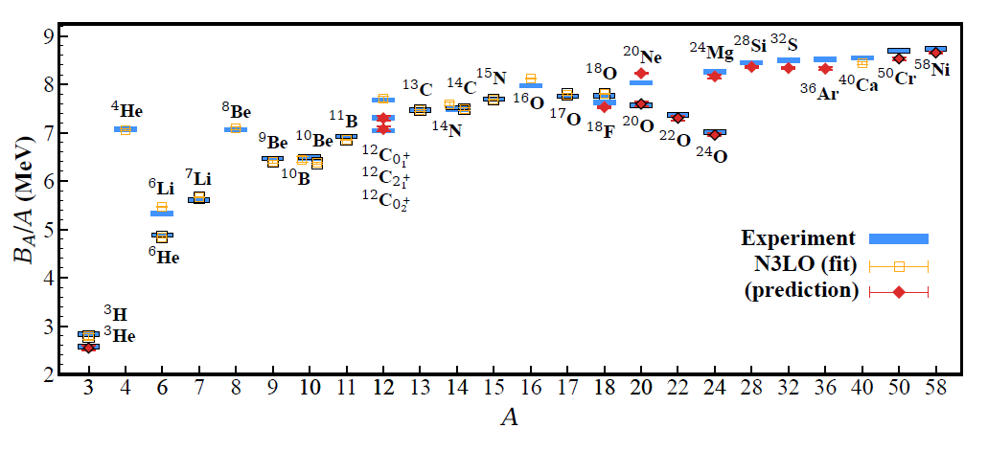
BE/A from WFM
RMSD ~ 0.1 MeV per nucleon
Accepted by Nature recently

Slide 9
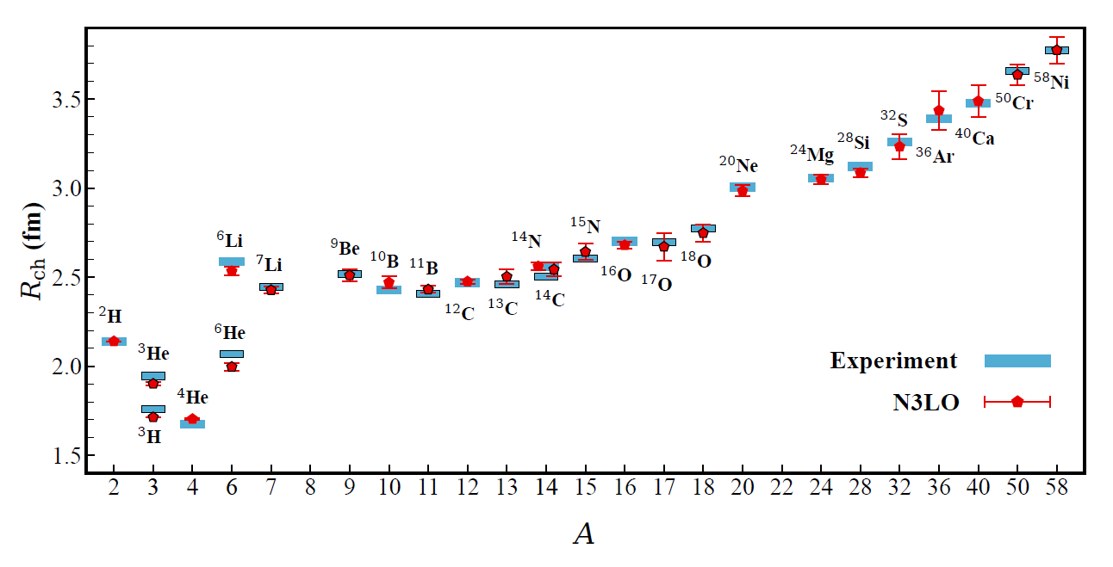
Charge Radius
No fitting! RMSD~ 0.03 fm

Slide 10
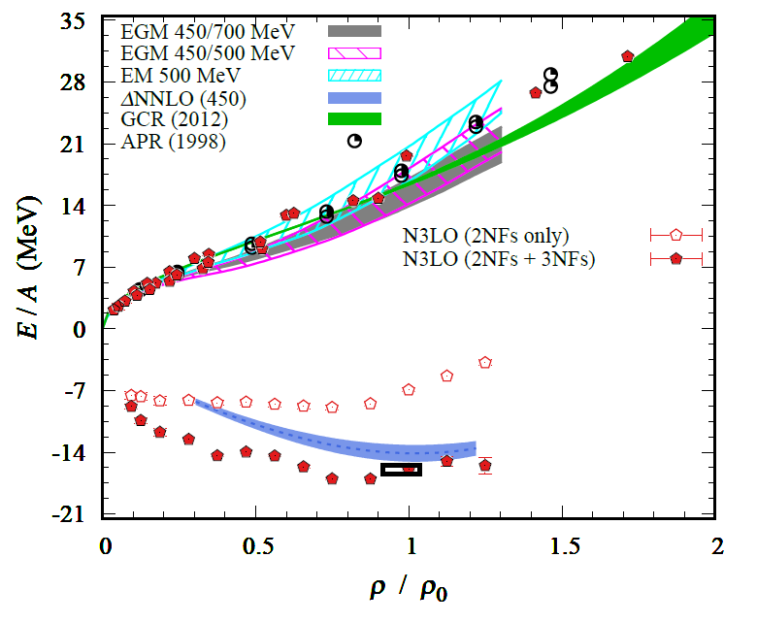
Nuclear/Neutron Matter
Neutron matter:
A=4~80
box size 6.6 ~ 13.2 fm.
Nuclear matter:
A=4 ~ 160
Box size 7.92~9.24 fm.
Uncertainties from
finite system size correction

Slide 11
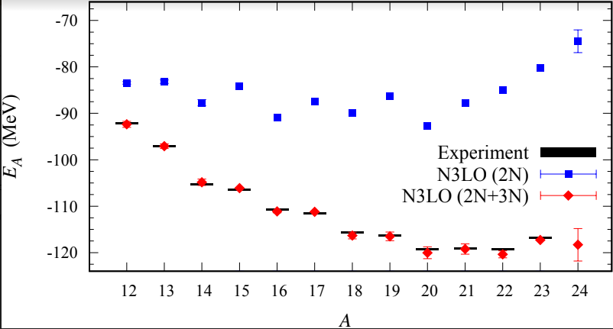
Carbon isotopes

Slide 12
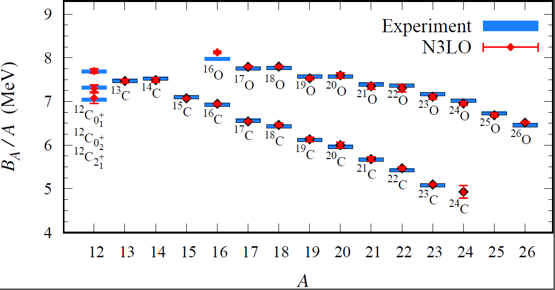
Carbon and Oxygen
Preliminary

Slide 13
How can we understand the dripline?
Although fully ab initio calculation of dripline was possible,
Mean field picture is very useful to understand the general behavior.
For example, core potential in a shell model with core.
How can we find more simple picture which describe the dripline? What is the most important property of the potential to get the dripline?
Fully ab-initio approach
Half ab-initio/phenomenological approach
Warning: This is on-going work and no final results are available.

Slide 14
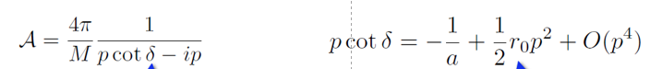
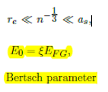
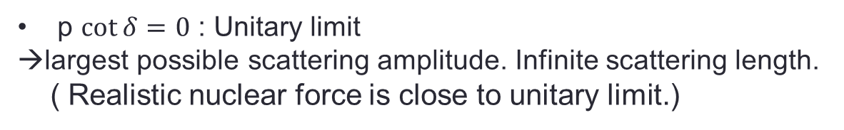
Dripline for unitary Fermions
Unitary Fermion Gas :
A strongly coupled conformal system
Physically interesting multi-fermion system with simple interaction
p $\cot{δ}=0$ : Unitary limit
→largest possible scattering amplitude. Infinite scattering length.
( Realistic nuclear force is close to unitary limit.)
Universality of unitary limit of many fermion system
→ Bertsch Parameter

Slide 15
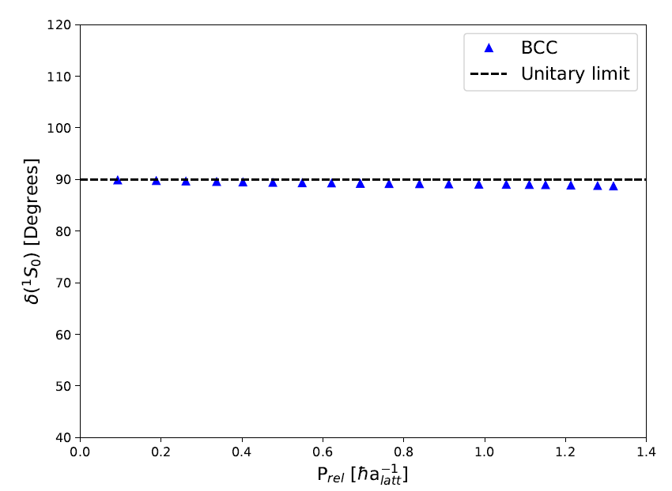
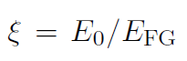
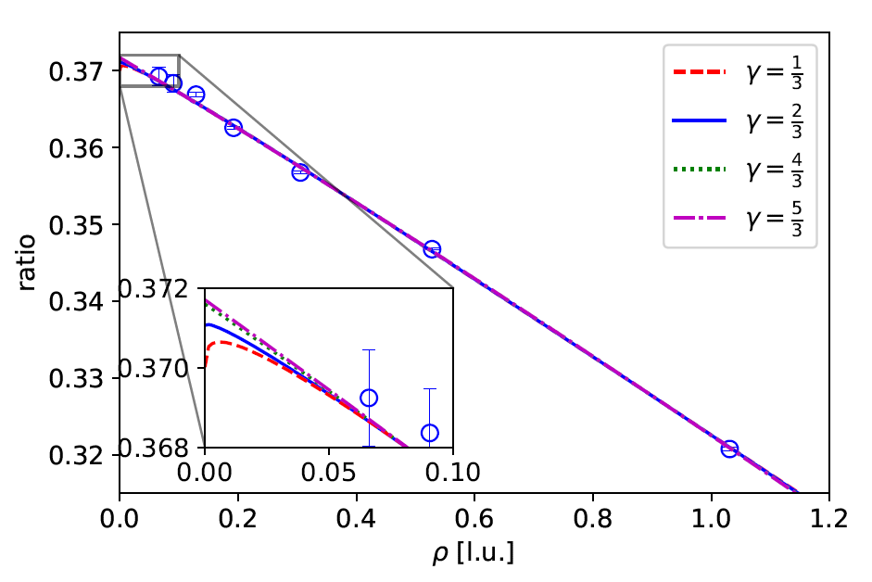
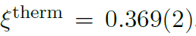
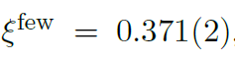
Unitary limit Hamiltonian
1S0 NN scattering phase shift is fitted for unitary limit .
→ Very large scattering length.
In cubic and BCC lattice
N=66 neutrons (33 spin up, 33 spin down)
L = 4,…, 10
Cubic lattice
BCC lattice

Slide 16
Unitary Fermions under trap
Unitary Fermion itself does not form a bound nuclei
→ Introduce an external spherical well potential
Can we find a relation between trap shape and dripline?
Separation energy have to be calculated accurately
→ Use an re-weighting method to reduce error in separation energy.
(correlated error estimation in energy difference.)
Unfortunately, realistic mean-field potential is rather expensive.
(reaching dripline in Unitary limits is difficult.)
→ limited to shallow external potential.
Try to see the dependence on parameter : y0 = m R^2 V
(Work in progress. Only preliminary results)

Slide 17
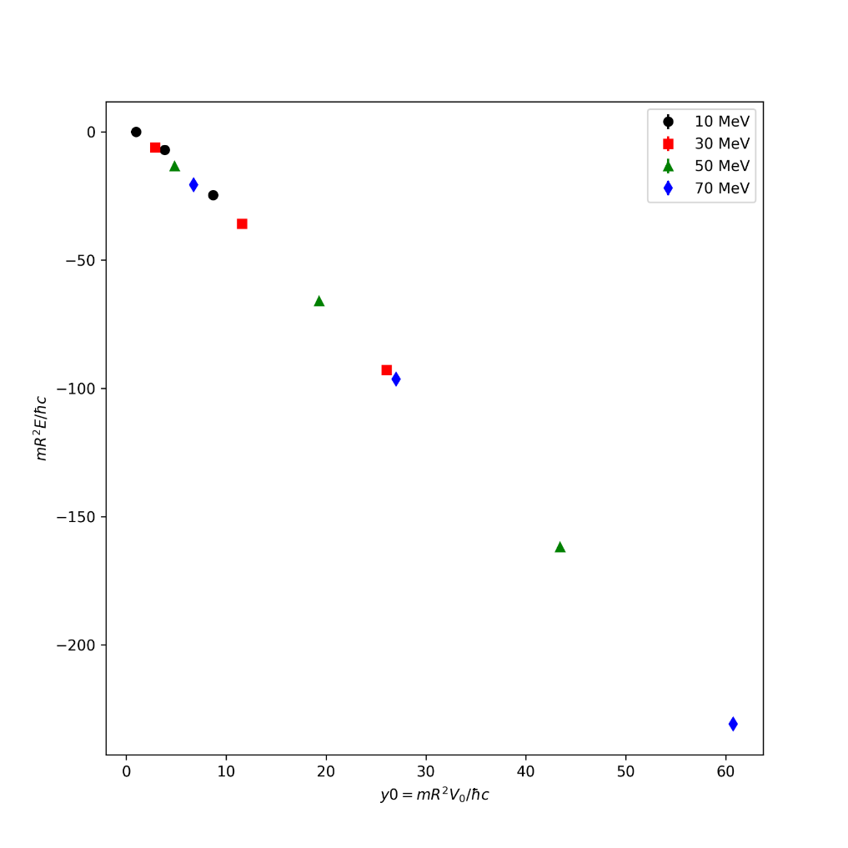
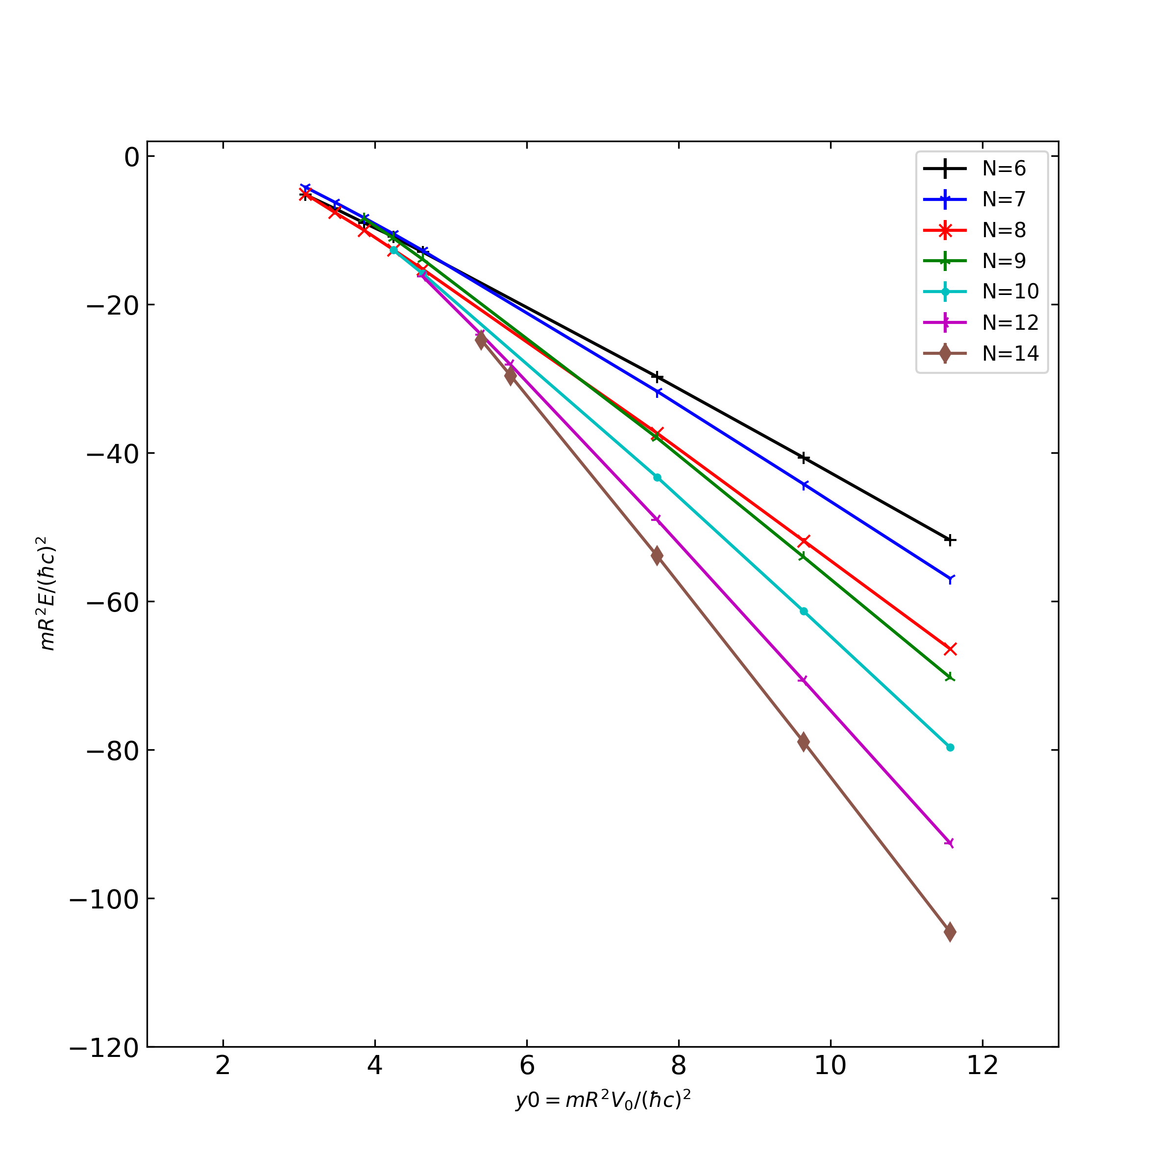
Neutrons in trap
4n

Slide 18
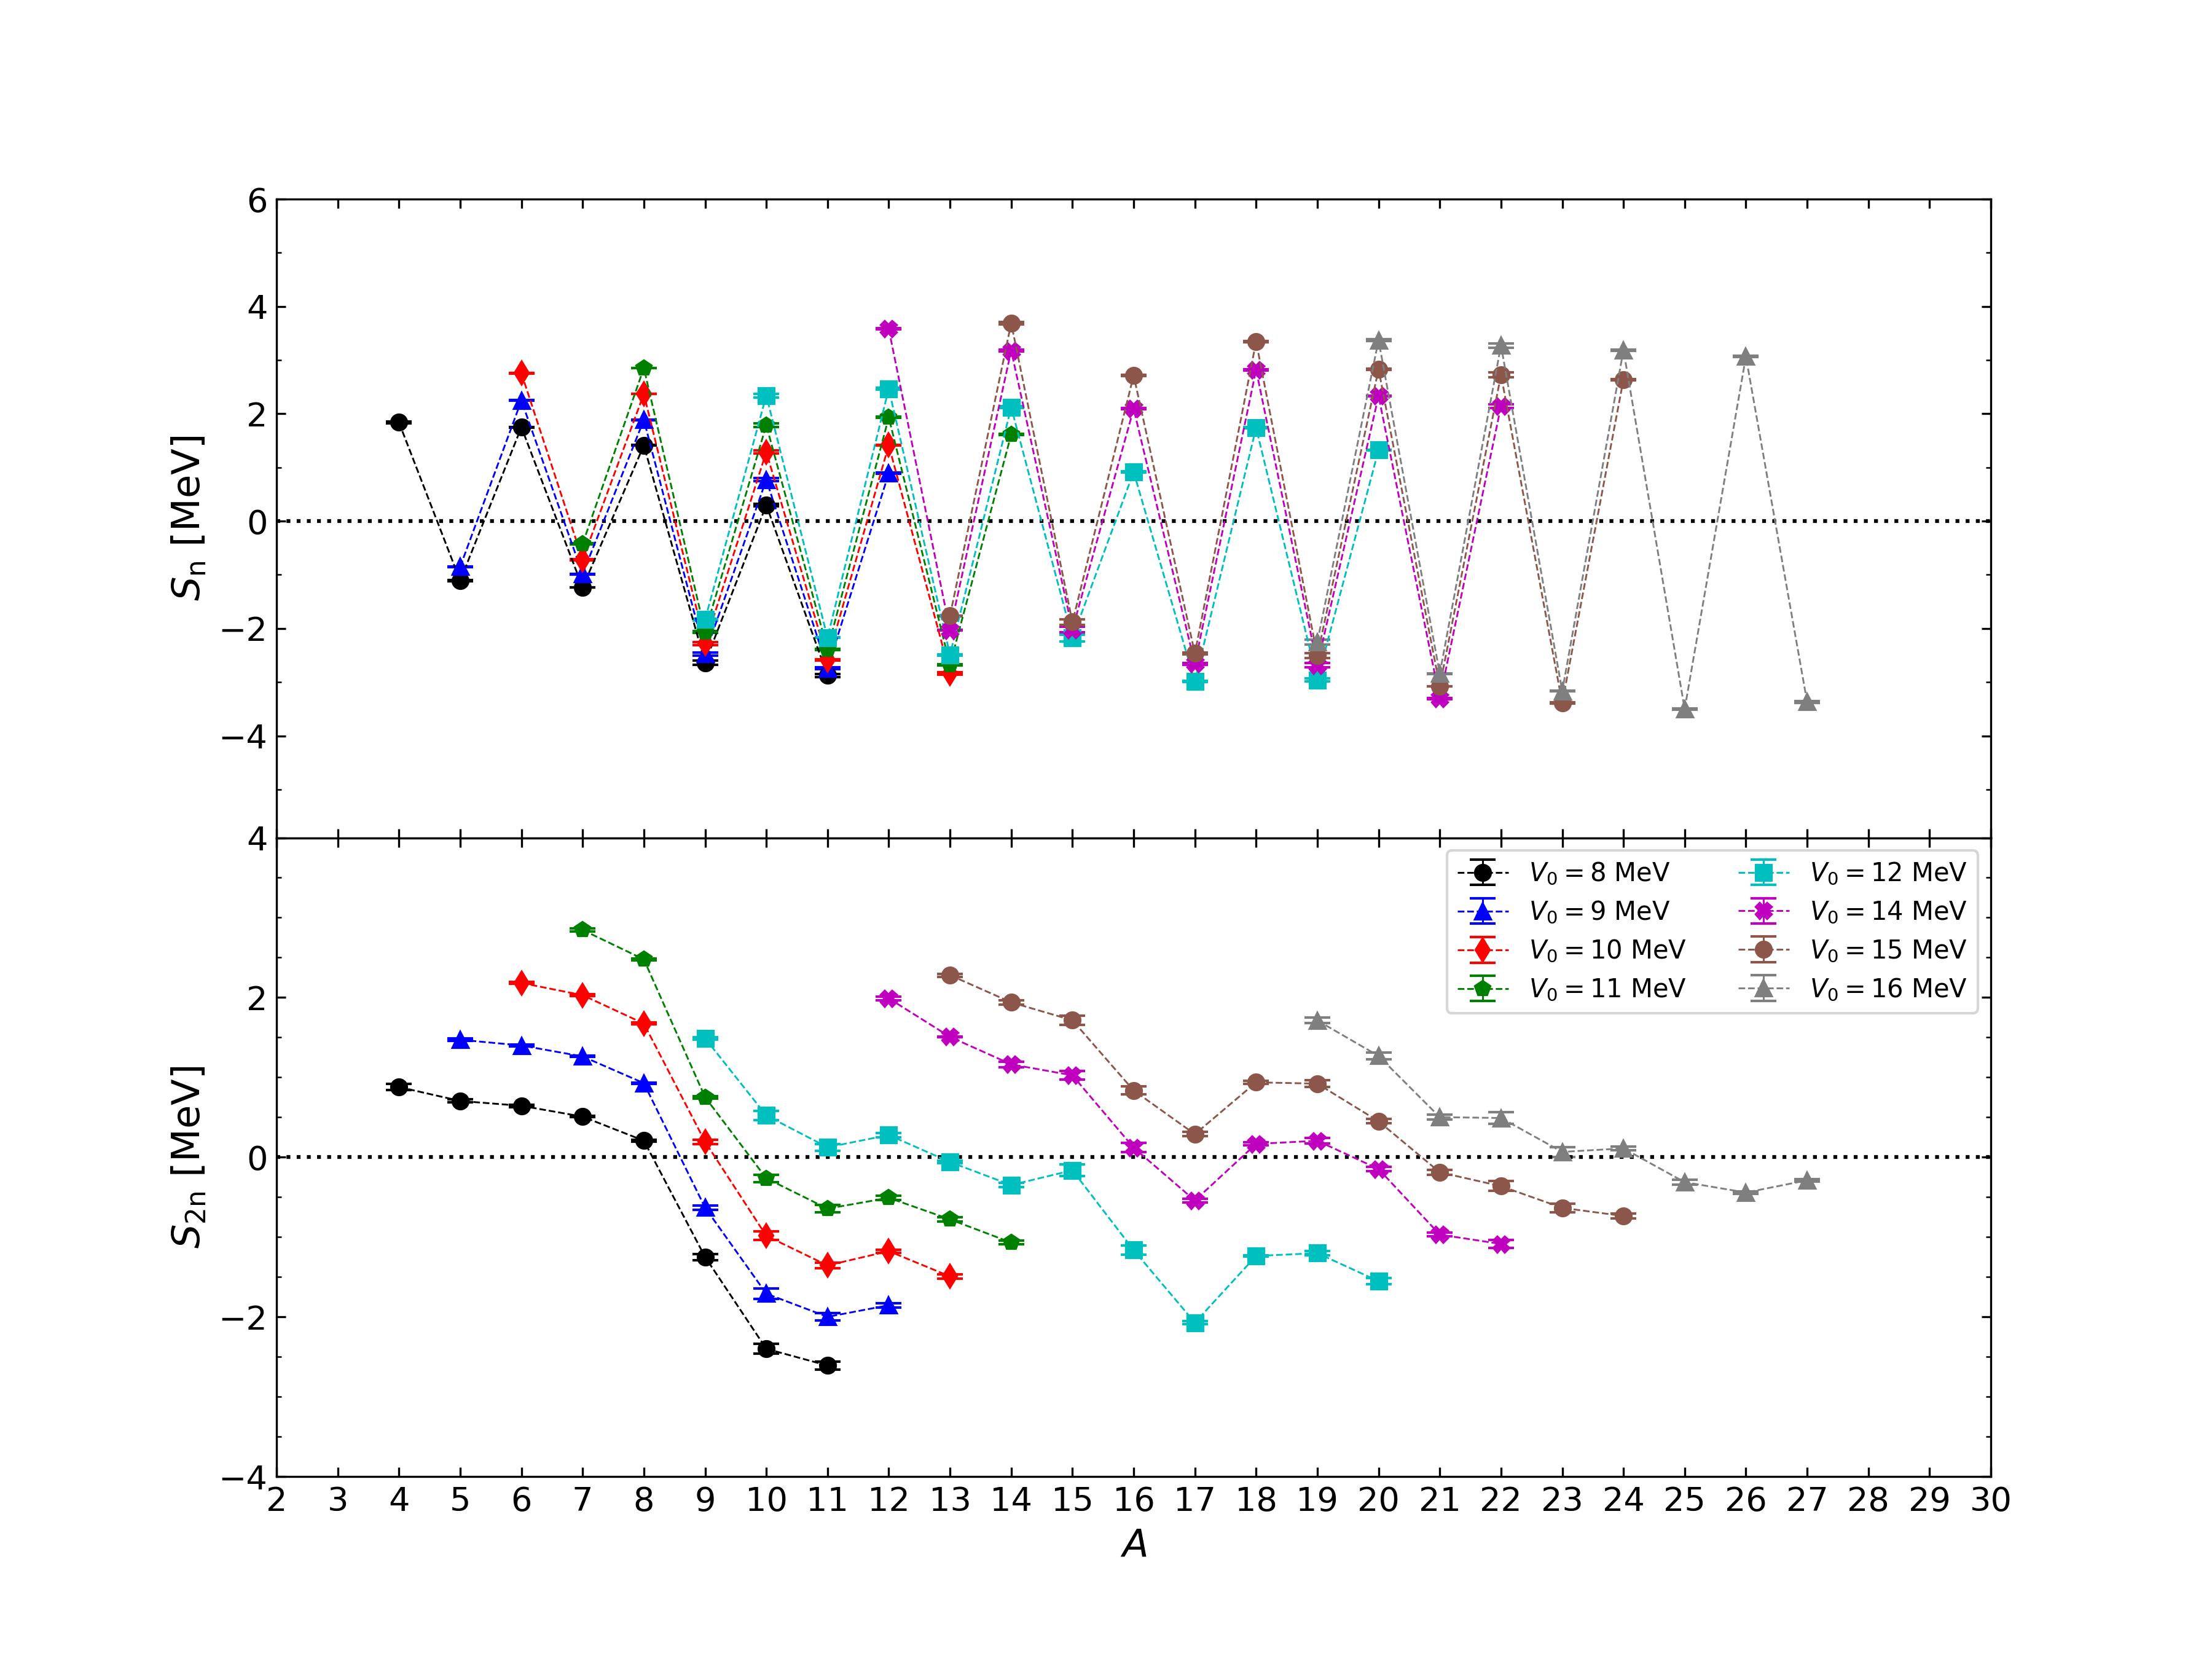
Separation energies
Lattice spacing 100 MeV
Spherical well
radius~ 4fm
Unitary limit interaction
has too strong pairing!
Preliminary

Slide 19
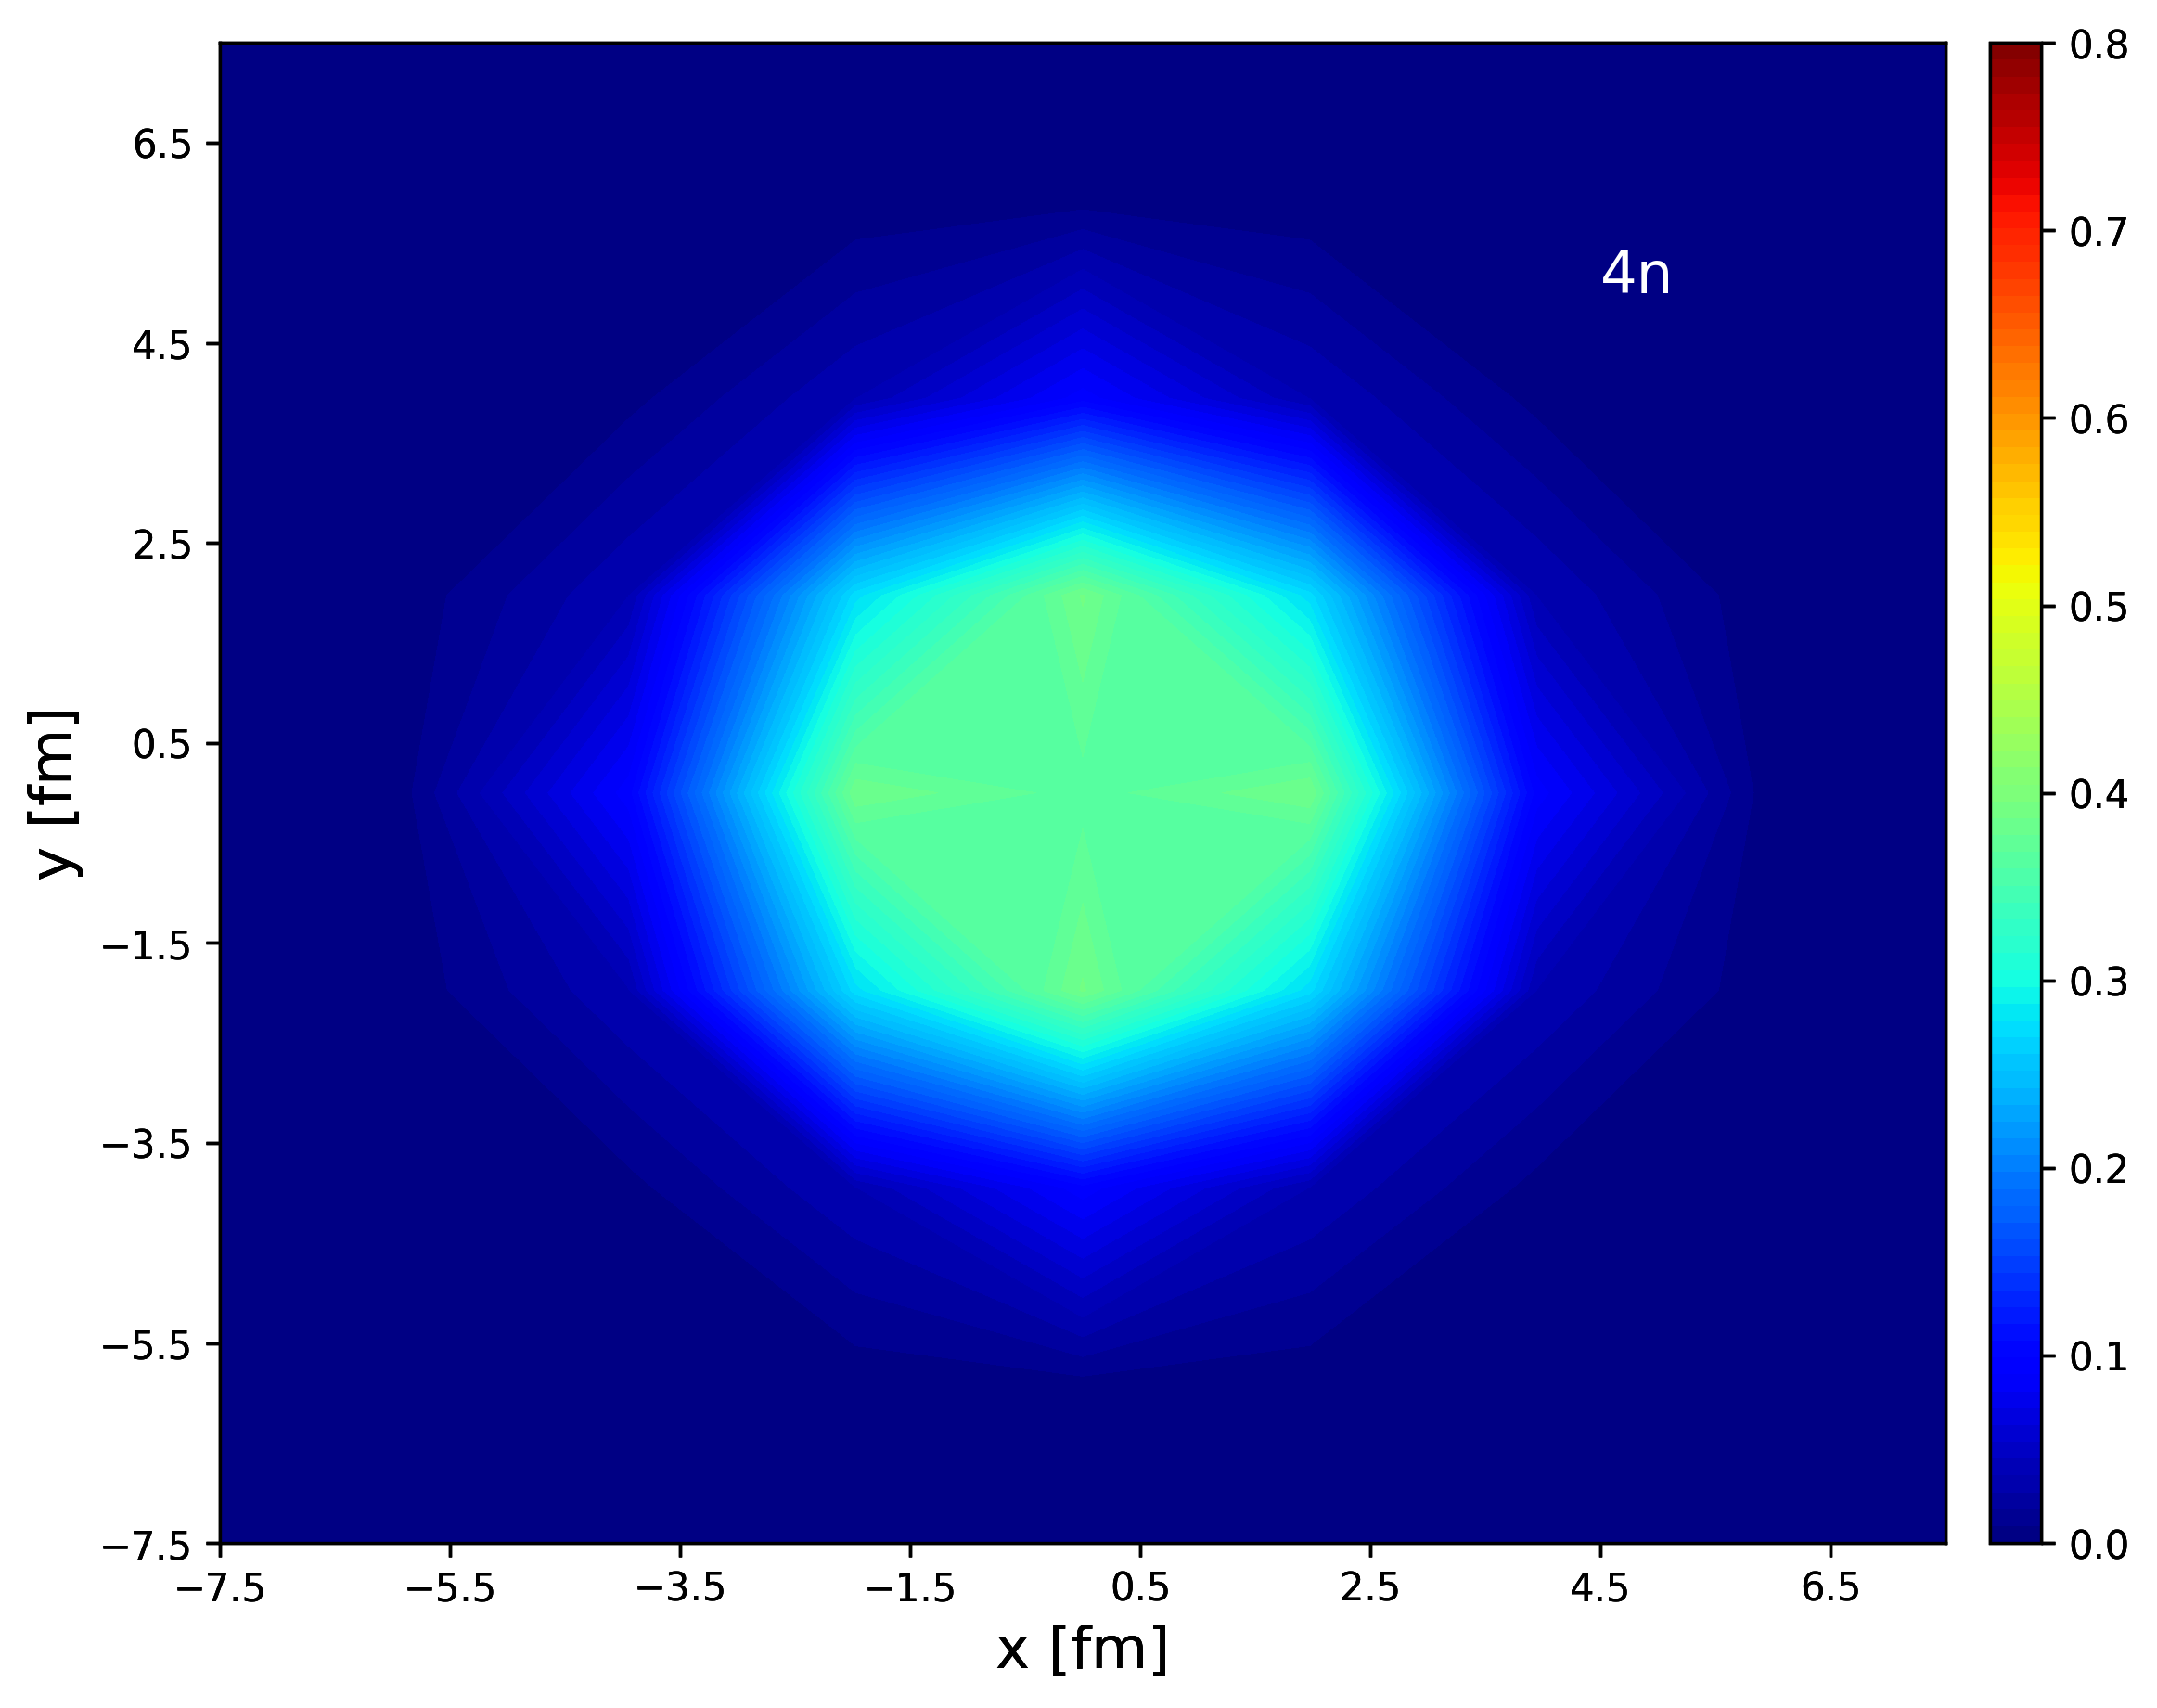
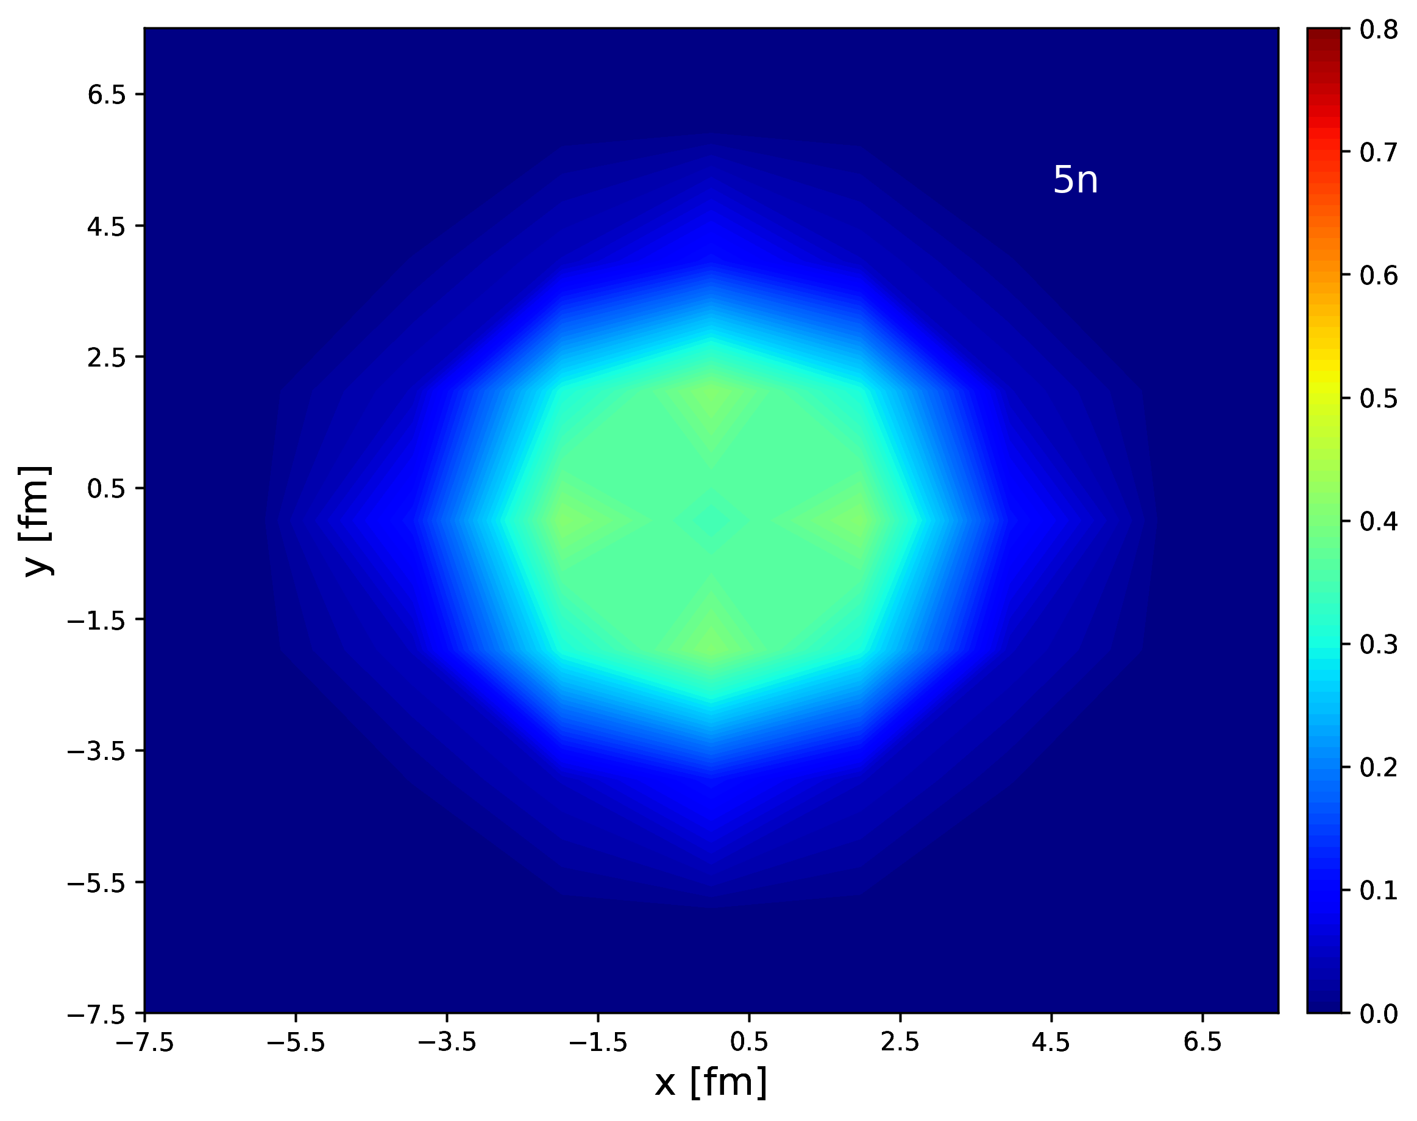
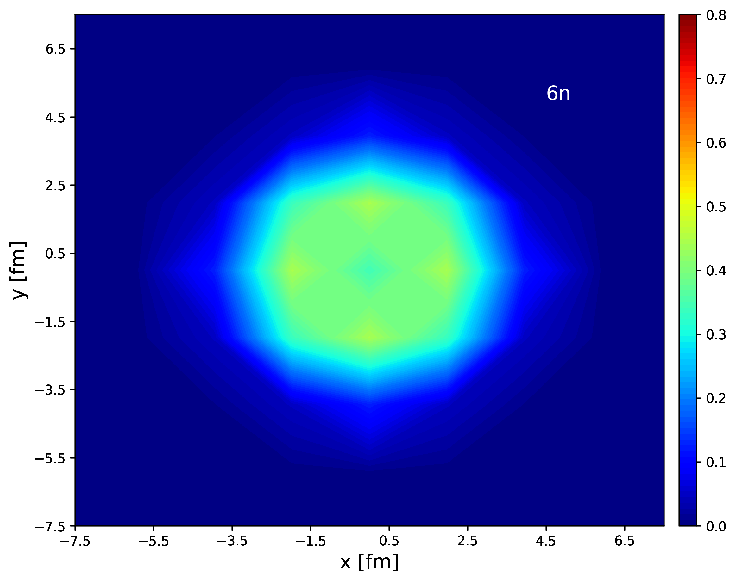
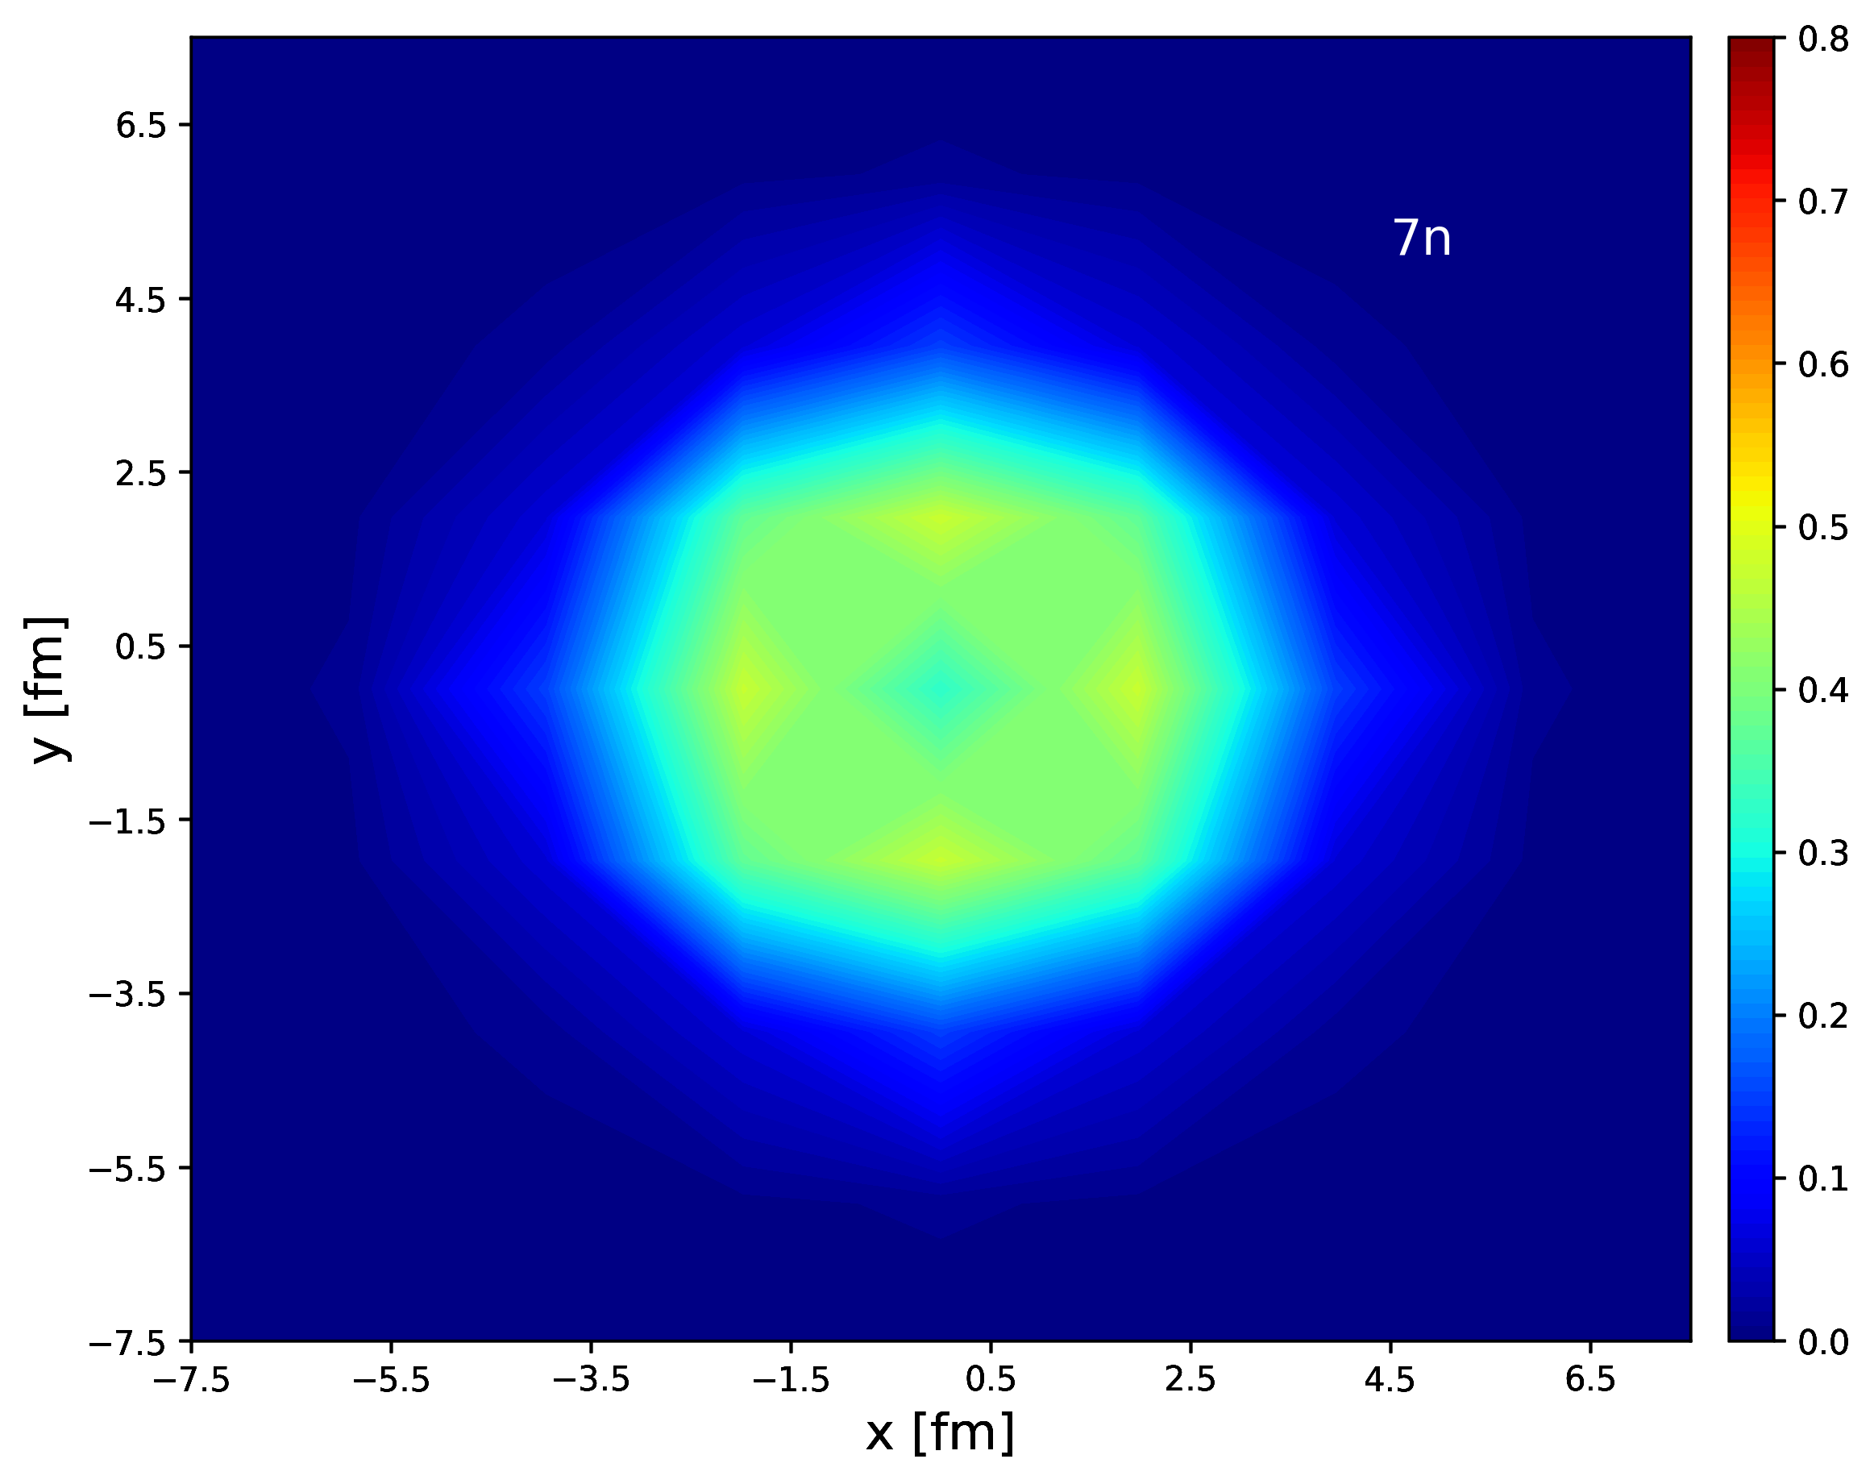
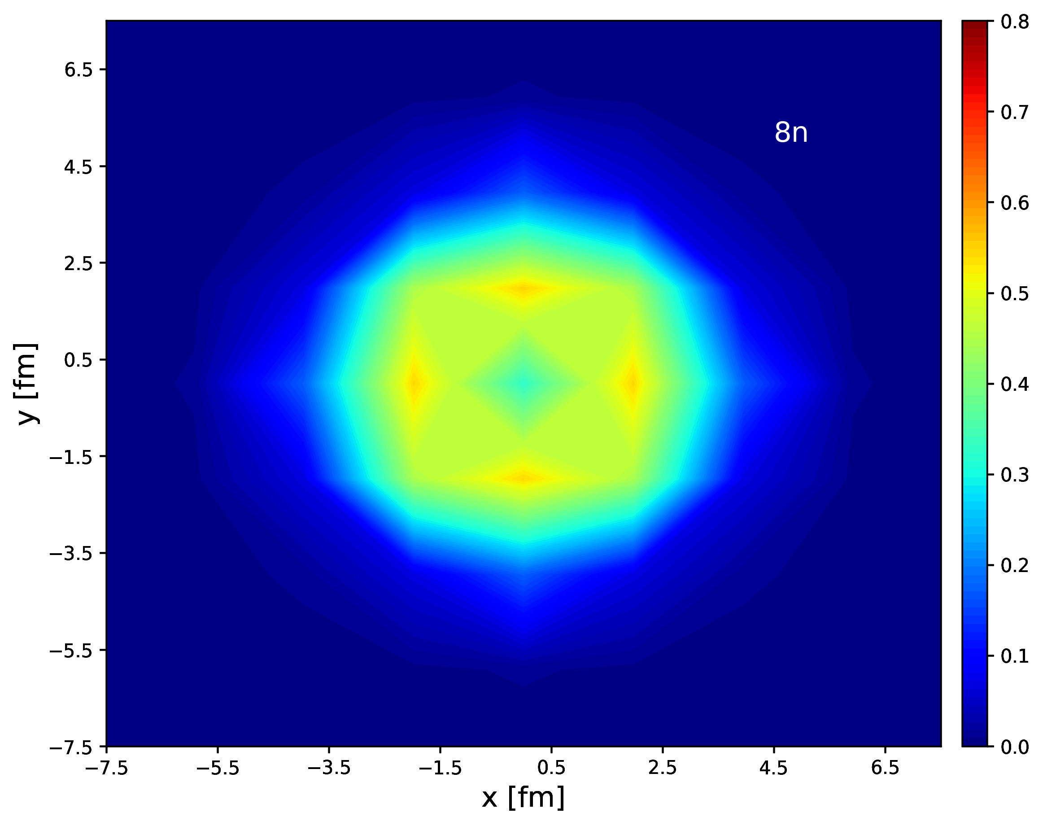
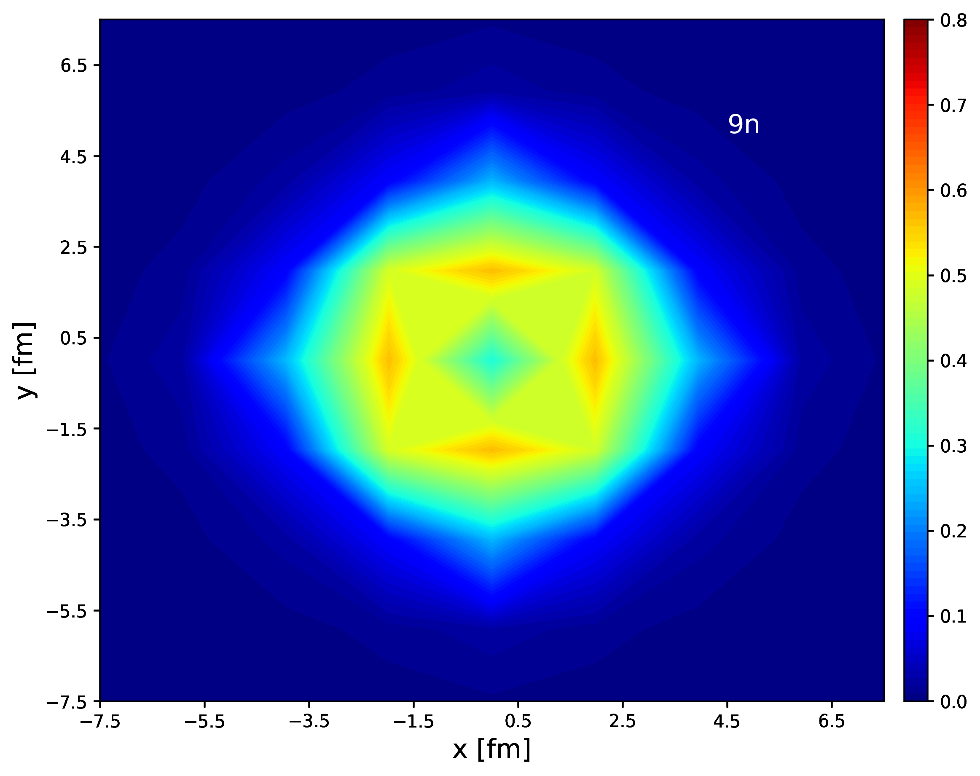
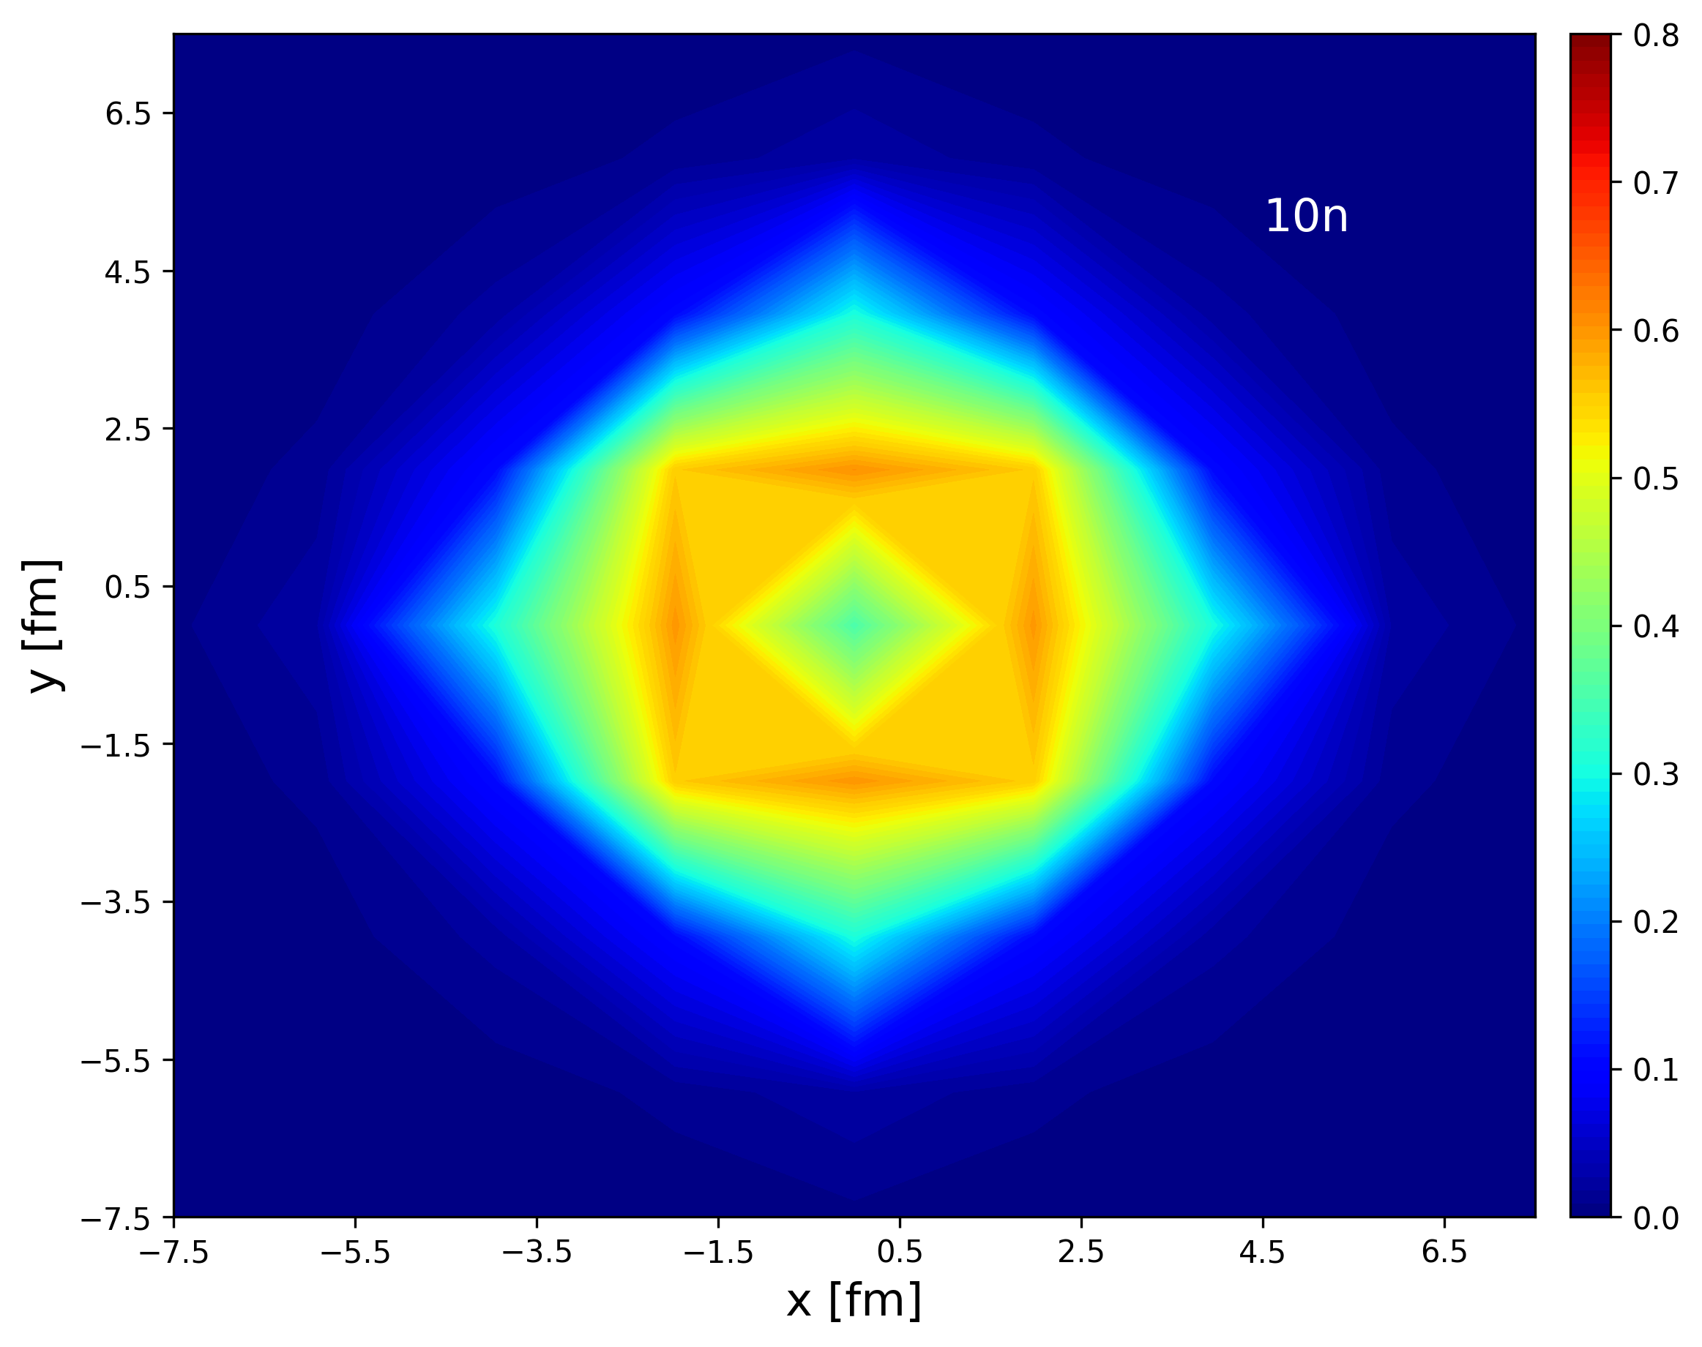

V0=8MeV density contour
Preliminary

Slide 20
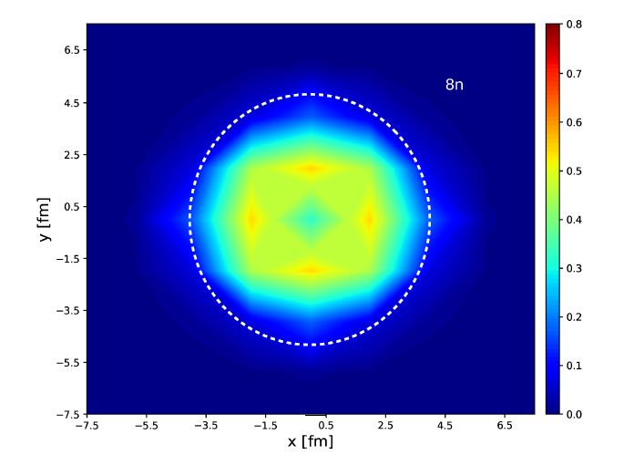
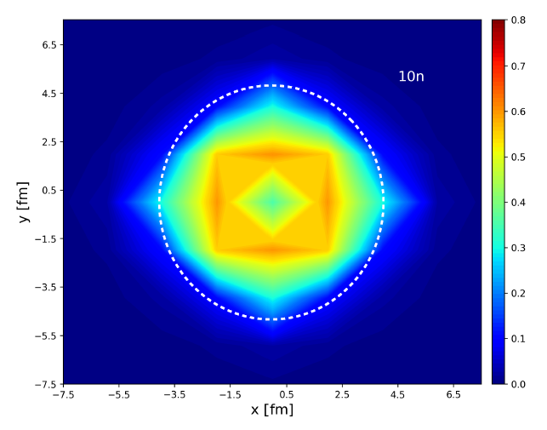
V0=8MeV density contour
Preliminary

Slide 21
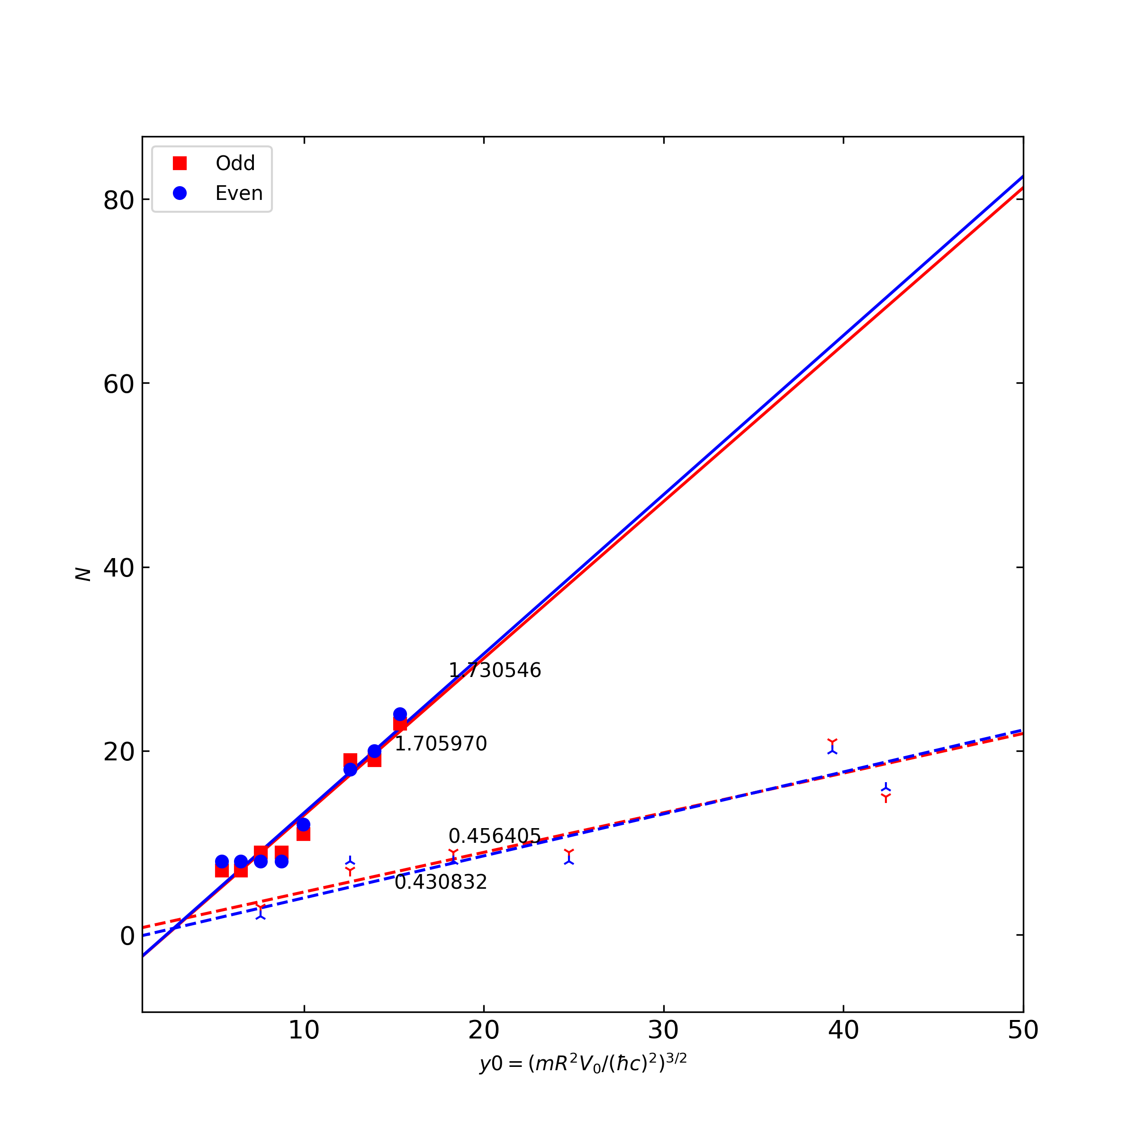
Extrapolation?
Linear Fit
Needs More data
Unitary limit interaction has too strong pairing.
getting mean field potential for the last neutron by using inverse method→ not accurate.
Preliminary

Slide 22
Mean field potential from protons?
Instead of inverse method to get mean field potential,
let us try to use half-phenomenological approach.
Oxygen isotopes as
Fully interacting neutrons ( WFM interaction up to N3LO)
Replace proton contributions into WS potential
→ N neutrons under effective proton mean field.
What kind of effective potential will give experimental separation energies?
Searching for the best Woods-Saxon potential form
Preliminary

Slide 23
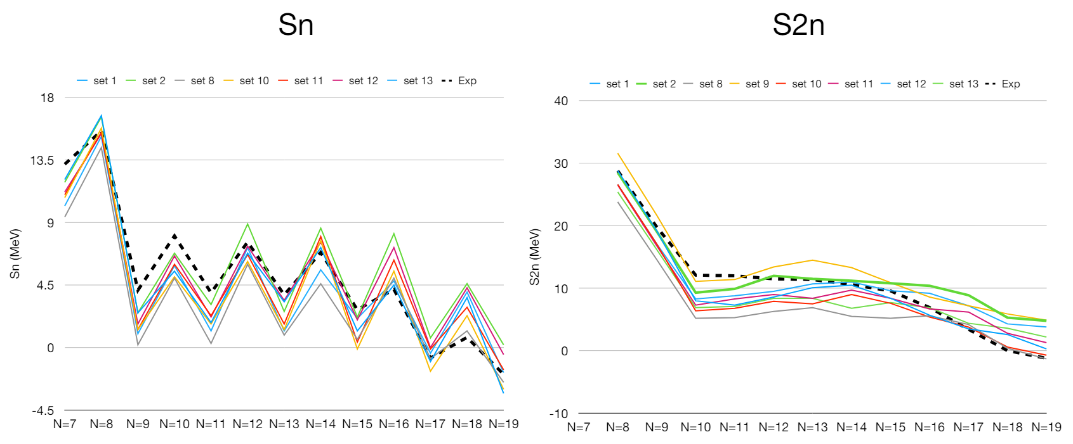
Mean field potential from protons?
Variation of WS potential parameters
depth : -45 ~ -50 MeV,
Diffuseness : 0.5 ~ 0.7 fm
Radius : 2.52 fm
Preliminary

Slide 24
Summary
How one can get a simple mean field picture of dripline from ab initio ?
Unitary limit Fermion system: simple but too strong pairing for dripline.
Half-Phenomenological approach:
Searching for the basic property of mean field potential.
Still preliminary stage.

